Slide 1
Packages

Slide 2
Packages
Packages are containers for classes that are used to keep the class name space compartmentalized.
For example, a package allows you to create a class named List, which you can store in your own package without concern that it will collide with some other class named List stored elsewhere.
Packages are stored in a hierarchical manner and are explicitly imported into new class definitions.

Slide 3
Packages
Through the use of the interface keyword, Java allows you to fully abstract the interface from its implementation.
Using interface, you can specify a set of methods that can be implemented by one or more classes.
The interface, itself, does not actually define any implementation.
Although they are similar to abstract classes, interfaces have an additional capability:
A class can implement more than one interface.
By contrast, a class can only inherit a single superclass (abstract or otherwise).

Slide 4
Packages
This means that a unique name had to be used for each class to avoid name collisions.
After a while, without some way to manage the name space, you could run out of convenient, descriptive names for individual classes.
You also need some way to be assured that the name you choose for a class will be reasonably unique and not collide with class names chosen by other programmers.
(Imagine a small group of programmers fighting over who gets to use the name “Foobar” as a class name.
Or, imagine the entire Internet community arguing over who first named a class “Espresso.”) Thankfully, Java provides a mechanism for partitioning the class name space into more manageable chunks. This mechanism is the package.
The package is both a naming and a visibility control mechanism. You can define classes inside a package that are not accessible by code outside that package.
You can also define class members that are only exposed to other members of the same package.
This allows your classes to have intimate knowledge of each other, but not expose that knowledge to the rest of the world.

Slide 5
Defining a Package
While the default package is fine for short, sample programs, it is inadequate for real applications.
Most of the time, you will define a package for your code.
This is the general form of the package statement:
package pkg;
Here, pkg is the name of the package. For example, the following statement creates a package called MyPackage.
package MyPackage;
To create a package is quite easy: simply include a package command as the first statement in a Java source file.
Any classes declared within that file will belong to the specified package.
The package statement defines a name space in which classes are stored. If you omit the package statement, the class names are put into the default package, which has no name.
(This is why you haven’t had to worry about packages before now.)

Slide 6
You can create a hierarchy of packages. To do so, simply separate each package name from the one above it by use of a period. The general form of a multileveled package statement is shown here:
package pkg1[.pkg2[.pkg3]];
A package hierarchy must be reflected in the file system of your Java development system. For example, a package declared as
package java.awt.image;
Java uses file system directories to store packages.
For example, the .class files for any classes you declare to be part of MyPackage must be stored in a directory called MyPackage.
Remember that case is significant, and the directory name must match the package name exactly.
More than one file can include the same package statement. The package statement simply specifies to which package the classes defined in a file belong.
It does not exclude other classes in other files from being part of that same package. Most real-world packages are spread across many files.

Slide 7
Finding Packages and CLASSPATH
As just explained, packages are mirrored by directories.
This raises an important question: How does the Java run-time system know where to look for packages that you create?
The answer has three parts.
First, by default, the Java run-time system uses the current working directory as its starting point. Thus, if your package is in a subdirectory of the current directory, it will be found.
Second, you can specify a directory path or paths by setting the CLASSPATH environmental variable.
Third, you can use the -classpath option with java and javac to specify the path to your classes. For example, consider the following package specification:
package MyPack
In order for a program to find MyPack, one of three things must be true.
Either the program can be executed from a directory immediately above MyPack, or the CLASSPATH must be set to include the path to MyPack, or the -classpath option must specify the path to MyPack when the program is run via java.

Slide 8
The easiest way to try the examples shown in this book is to simply create the package directories below your current development directory, put the .class files into the appropriate directories, and then execute the programs from the development directory.
This is the approach used in the following example.
When the second two options are used, the class path must not include MyPack, itself. It must simply specify the path to MyPack. For example, in a Windows environment, if the path to MyPack is
C:\MyPrograms\Java\MyPack
Then the class path to MyPack is
C:\MyPrograms\Java

Slide 9
A Short Package Example Keeping the preceding discussion in mind
class AccountBalance {
public static void main(String args[]) {
Balance current[] = new Balance[3]; current[0] = new Balance("K. J. Fielding", 123.23);
current[1] = new Balance("Will Tell", 157.02);
current[2] = new Balance("Tom Jackson", -12.33);
for(int i=0; i<3; i++) current[i].show();
}
}
Call this file AccountBalance.java and put it in a directory called MyPack. Next, compile the file. Make sure that the resulting .class file is also in the MyPack directory. Then, try executing the AccountBalance class, using the following command line:
java MyPack.AccountBalance
// A simple package
package MyPack;
class Balance {
String name;
double bal;
Balance(String n, double b) {
name = n;
bal = b;
}
void show() {
if(bal<0)
System.out.print("--> ");
System.out.println(name + ": $" + bal);
}
}

Slide 10
Remember, you will need to be in the directory above MyPack when you execute this command.
(Alternatively, you can use one of the other two options described in the preceding section to specify the path MyPack.) As explained, AccountBalance is now part of the package MyPack.
This means that it cannot be executed by itself. That is, you cannot use this command line:
java AccountBalance
AccountBalance must be qualified with its package name.

Slide 11
Access Protection
Packages act as containers for classes and other subordinate packages. Classes act as containers for data and code.
The class is Java’s smallest unit of abstraction.
Because of the interplay between classes and packages, Java addresses four categories of visibility for class members:
• Subclasses in the same package
• Non-subclasses in the same package
• Subclasses in different packages
• Classes that are neither in the same package nor subclasses
you learned about various aspects of Java’s access control mechanism and its access specifiers.
For example, you already know that access to a private member of a class is granted only to other members of that class.
Packages add another dimension to access control.
Java provides many levels of protection to allow fine-grained control over the visibility of variables and methods within classes, subclasses, and packages.
Classes and packages are both means of encapsulating and containing the name space and scope of variables and methods.

Slide 12
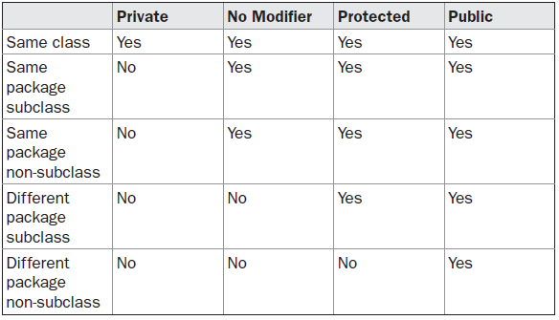
The three access specifiers, private, public, and protected, provide a variety of ways to produce the many levels of access required by these categories.
While Java’s access control mechanism may seem complicated, we can simplify it as follows.
Anything declared public can be accessed from anywhere. Anything declared private cannot be seen outside of its class.
When a member does not have an explicit access specification, it is visible to subclasses as well as to other classes in the same package.

Slide 13
This is the default access. If you want to allow an element to be seen outside your current package, but only to classes that subclass your class directly, then declare that element protected. Table 9-1 applies only to members of classes.
A non-nested class has only two possible access levels: default and public.
When a class is declared as public, it is accessible by any other code.
If a class has default access, then it can only be accessed by other code within its same package.
When a class is public, it must be the only public class declared in the file, and the file must have the same name as the class.

Slide 14
Example has two packages and five classes. The classes for the two different packages need to be stored in directories named after their respective packages—in this case, p1 and p2.
The source for the first package defines three classes: Protection, Derived, and SamePackage. The first class defines four int variables in each of the legal protection modes.
The variable n is declared with the default protection, n_pri is private, n_pro is protected, and n_pub is public.
The second class, Derived, is a subclass of Protection in the same package, p1.
This grants Derived access to every variable in Protection except for n_pri, the private one.
The third class, SamePackage, is not a subclass of Protection, but is in the same package and also has access to all but n_pri.

Slide 15
This is file Protection.java:
This is file Derived.java:
package p1;
class Derived extends Protection {
Derived() {
System.out.println("derived constructor");
System.out.println("n = " + n);
// class only
// System.out.println("n_pri = "4 + n_pri);
System.out.println("n_pro = " + n_pro);
System.out.println("n_pub = " + n_pub);
}
}
package p1;
public class Protection {
int n = 1;
private int n_pri = 2;
protected int n_pro = 3;
public int n_pub = 4;
public Protection() {
System.out.println("base constructor");
System.out.println("n = " + n);
System.out.println("n_pri = " + n_pri);
System.out.println("n_pro = " + n_pro);
System.out.println("n_pub = " + n_pub);
}
}

Slide 16
This is file SamePackage.java
This is file Protection2.java:
package p1;
class SamePackage {
SamePackage() {
Protection p = new Protection();
System.out.println("same package constructor");
System.out.println("n = " + p.n);
// class only
// System.out.println("n_pri = " + p.n_pri);
System.out.println("n_pro = " + p.n_pro);
System.out.println("n_pub = " + p.n_pub);
}
}
package p2;
class Protection2 extends p1.Protection {
Protection2() {
System.out.println("derived other package constructor");
// class or package only
// System.out.println("n = " + n);
// class only
// System.out.println("n_pri = " + n_pri);
System.out.println("n_pro = " + n_pro);
System.out.println("n_pub = " + n_pub);
}
}

Slide 17

This is file OtherPackage.java:
// Demo package p1.
package p1;
// Instantiate the various classes in p1.
public class Demo {
public static void main(String args[]) {
Protection ob1 = new Protection();
Derived ob2 = new Derived();
SamePackage ob3 = new SamePackage();
}
}
package p2;
class OtherPackage {
OtherPackage() {
p1.Protection p = new p1.Protection();
System.out.println("other package constructor");
// class or package only
// System.out.println("n = " + p.n);
// class only
// System.out.println("n_pri = " + p.n_pri);
// class, subclass or package only
// System.out.println("n_pro = " + p.n_pro);
System.out.println("n_pub = " + p.n_pub);
}
}

Slide 18
// Demo package p2.
package p2;
// Instantiate the various classes in p2.
public class Demo {
public static void main(String args[]) {
Protection2 ob1 = new Protection2();
OtherPackage ob2 = new OtherPackage();
}
}
when a package is imported, only those items within the package declared as public will be available to non-subclasses in the importing code.
For example, if you want the Balance class of the package MyPack shown earlier to be available as a stand-alone class for general use outside of MyPack, then you will need to declare it as public and put it into its own file,

Slide 19
Importing Packages
There are no core Java classes in the unnamed default package; all of the standard classes are stored in some named package.
Since classes within packages must be fully qualified with their package name or names, it could become tedious to type in the long dot-separated package path name for every class you want to use.
For this reason, Java includes the import statement to bring certain classes, or entire packages, into visibility.
Once imported, a class can be referred to directly, using only its name. import statements occur immediately following the package statement (if it exists) and before any class definitions.
This is the general form of the import statement:
import pkg1[.pkg2].(classname|*);
pkg1 is the name of a top-level package, and pkg2 is the name of a subordinate package inside the outer package separated by a dot (.).
There is no practical limit on the depth of a package hierarchy, except that imposed by the file system.
Either an explicit classname or a star (*), which indicates that the Java compiler should import the entire package. This code fragment shows both forms in use:
import java.util.Date;
import java.io.*;

Slide 20
All of the standard Java classes included with Java are stored in a package called java.
The basic language functions are stored in a package inside of the java package called java.lang.
Normally, you have to import every package or class that you want to use, but since Java is useless without much of the functionality in java.lang, it is implicitly imported by the compiler for all programs.
This is equivalent to the following line being at the top of all of your programs:
import java.lang.*;
If a class with the same name exists in two different packages that you import using the star form, the compiler will remain silent, unless you try to use one of the classes. In that case, you will get a compile-time error and have to explicitly name the class specifying its package.
It must be emphasized that the import statement is optional. Any place you use a class name, you can use its fully qualified name, which includes its full package hierarchy.
For example, this fragment uses an import statement:
import java.util.*;
class MyDate extends Date {
}
The same example without the import statement looks like this:
class MyDate extends java.util.Date {
}

Slide 21
when a package is imported, only those items within the package declared as public will be available to non-subclasses in the importing code. For example, if you want the Balance class of the package MyPack shown earlier to be available as a stand-alone class for general use outside of MyPack, then you will need to declare it as public and put it into its own file,
package MyPack;
/* Now, the Balance class, its constructor, and its
show() method are public. This means that they can
be used by non-subclass code outside their package.
*/
public class Balance {
String name;
double bal;
public Balance(String n, double b) {
name = n;
bal = b;
}
public void show() {
if(bal<0)
System.out.print("--> ");
System.out.println(name + ": $" + bal);
}
}

Slide 22
As you can see, the Balance class is now public. Also, its constructor and its show( )
method are public, too. This means that they can be accessed by any type of code outside
the MyPack package. For example, here TestBalance imports MyPack and is then able to
make use of the Balance class:
import MyPack.*;
class TestBalance {
public static void main(String args[]) {
/* Because Balance is public, you may use Balance
class and call its constructor. */
Balance test = new Balance("J. J. Jaspers", 99.88);
test.show(); // you may also call show()
}
}

Slide 23
Java Anonymous Class
class outerClass {
// defining anonymous class
object1 = new Type(parameterList) {
// body of the anonymous class
};
}
Anonymous classes usually extend subclasses or implement interfaces.
Here, Type can be
a superclass that an anonymous class extends
an interface that an anonymous class implements
In Java, a class can contain another class known as nested class. It's possible to create a nested class without giving any name.
A nested class that doesn't have any name is known as an anonymous class.
An anonymous class must be defined inside another class. Hence, it is also known as an anonymous inner class. Its syntax is:

Slide 24
Note: Anonymous classes are defined inside an expression. So, the semicolon is used at the end of anonymous classes to indicate the end of the expression. Anonymous Class Extending a Class| Anonymous Class Implementing an Interface
class Polygon {
public void display() {
System.out.println("Inside the Polygon class");
}}
class AnonymousDemo {
public void createClass() {
// creation of anonymous class extending class Polygon
Polygon p1 = new Polygon() {
public void display() {
System.out.println("Inside an anonymous class.");
} };
p1.display();
}}
class Main {
public static void main(String[] args) {
AnonymousDemo an = new AnonymousDemo();
an.createClass();
}} Output: Inside an anonymous class.
interface Polygon {
public void display();
}
class AnonymousDemo {
public void createClass() {
// anonymous class implementing interface
Polygon p1 = new Polygon() {
public void display() {
System.out.println("Inside an anonymous class.");
} };
p1.display();
}}
class Main {
public static void main(String[] args) {
AnonymousDemo an = new AnonymousDemo();
an.createClass();
}}
Inside an anonymous class.

Slide 25
Advantages of Anonymous Classes
Object = new Example() {
public void display() {
System.out.println("Anonymous class overrides the method display().");
} };
an object of the anonymous class is created dynamically when we need to override the display() method.
Anonymous classes also help us to make our code concise.
In anonymous classes, objects are created whenever they are required. That is, objects are created to perform some specific tasks.

Slide 26
Concrete class in Java
A concrete class is a class that has an implementation for all of its methods. They cannot have any unimplemented methods. It can also extend an abstract class or implement an interface as long as it implements all their methods. It is a complete class and can be instantiated

Slide 27
//Make a program to implement calculator which performs general arithmetic operations like addition, multiplication etc. //Pass values and type of operation from command line argument.
public class Calculator {
public static void main(String args[]) {
if(args.length!=3) {
System.out.println("Usages: Java Calculator operand() operand1 and operand2");
System.exit(0); }
int result=0;
switch(args[1].charAt(0)) {
case '+': result=Integer.parseInt(args[0])+Integer.parseInt(args[2]); break;
case '-': result=Integer.parseInt(args[0])-Integer.parseInt(args[2]); break;
case '*': result=Integer.parseInt(args[0])*Integer.parseInt(args[2]); break;
case '/': result=Integer.parseInt(args[0])/Integer.parseInt(args[2]); break;
}
System.out.println(args[0]+' '+args[1]+' '+args[2]+"="+result); }
}

Slide 28
Exception Handing:
An exception is an unexpected event that occurs during program execution. It affects the flow of the program instructions which can cause the program to terminate abnormally.
An exception can occur for many reasons. Some of them are:
Invalid user input
Device failure
Loss of network connection
Physical limitations (out of disk memory)
Code errors
Opening an unavailable file

Slide 29
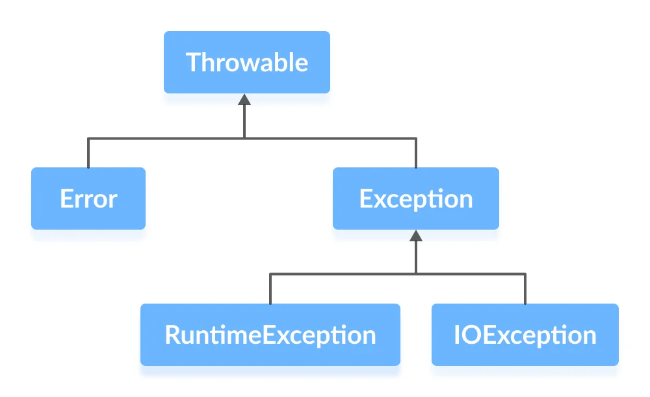
Java Exception hierarchy
Throwable class is the root class in the hierarchy.
Note that the hierarchy splits into two branches: Error and Exception.

Slide 30
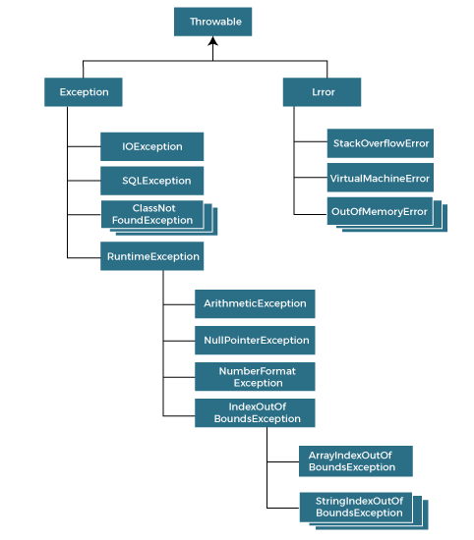

Slide 31
Java Exception
Errors
Exceptions
Errors represent irrecoverable conditions such as Java virtual machine (JVM) running out of memory, memory leaks, stack overflow errors, library incompatibility, infinite recursion, etc.
Errors are usually beyond the control of the programmer and we should not try to handle errors.
Exceptions can be caught and handled by the program.
When an exception occurs within a method, it creates an object. This object is called the exception object.
It contains information about the exception such as the name and description of the exception and state of the program when the exception occurred.

Slide 32
Java Exception Types: The exception hierarchy also has two branches: RuntimeException and IOException.
1. RuntimeException
A runtime exception happens due to a programming error. They are also known as unchecked exceptions.
These exceptions are not checked at compile-time but run-time. Some of the common runtime exceptions are:
Improper use of an API - IllegalArgumentException
Null pointer access (missing the initialization of a variable) - NullPointerException
Out-of-bounds array access - ArrayIndexOutOfBoundsException
Dividing a number by 0 - ArithmeticException
You can think about it in this way. “If it is a runtime exception, it is your fault”.
The NullPointerException would not have occurred if you had checked whether the variable was initialized or not before using it.
An ArrayIndexOutOfBoundsException would not have occurred if you tested the array index against the array bounds.

Slide 33
2. IOException
An IOException is also known as a checked exception. They are checked by the compiler at the compile-time and the programmer is prompted to handle these exceptions.
Some of the examples of checked exceptions are:
Trying to open a file that doesn’t exist results in FileNotFoundException
Trying to read past the end of a file

Slide 34
Java Exception Handling
try {
// code
}
catch(Exception e) {
// code
}
Here, we have placed the code that might generate an exception inside the try block. Every try block is followed by a catch block.
When an exception occurs, it is caught by the catch block. The catch block cannot be used without the try block.
Here's a list of different approaches to handle exceptions in Java.
try...catch block
finally block
throw and throws keyword
1. Java try...catch block
The try-catch block is used to handle exceptions in Java. Here's the syntax of try...catch block:

Slide 35
Example: Exception handling using try...catch
class Main {
public static void main(String[] args) {
try {
// code that generate exception
int divideByZero = 5 / 0;
System.out.println("Rest of code in try block");
}
catch (ArithmeticException e) {
System.out.println("ArithmeticException => " + e.getMessage());
}
}
}
Output
ArithmeticException => / by zero
In the example, we are trying to divide a number by 0. Here, this code generates an exception.
To handle the exception, we have put the code, 5 / 0 inside the try block. Now when an exception occurs, the rest of the code inside the try block is skipped.
The catch block catches the exception and statements inside the catch block is executed.
If none of the statements in the try block generates an exception, the catch block is skipped.

Slide 36
Exception-Handling Fundamentals
This is the general form of an exception-handling block:
try {
// block of code to monitor for errors
} catch (ExceptionType1 exOb) {
// exception handler for ExceptionType1
}
catch (ExceptionType2 exOb) {
// exception handler for ExceptionType2
}
// ...
finally {
// block of code to be executed after try block ends
}
Here, ExceptionType is the type of exception that has occurred. The remainder of this chapter
describes how to apply this framework.
Java exception handling is managed via five keywords: try, catch, throw, throws, and finally. Briefly, here is how they work.
Program statements that you want to monitor for exceptions are contained within a try block. If an exception occurs within the try block, it is thrown.
Your code can catch this exception (using catch) and handle it in some rational manner. System-generated exceptions are automatically thrown by the Java run-time system.
To manually throw an exception, use the keyword throw. Any exception that is thrown out of a method must be specified as such by a throws clause.
Any code that absolutely must be executed after a try block completes is put in a finally block.

Slide 37
Exception Types
The other branch is topped by Error, which defines exceptions that are not expected to be caught under normal circumstances by your program.
Exceptions of type Error are used by the Java run-time system to indicate errors having to do with the run-time environment, itself.
Stack overflow is an example of such an error.
This chapter will not be dealing with exceptions of type Error, because these are typically created in response to catastrophic failures that cannot usually be handled by your program.
All exception types are subclasses of the built-in class Throwable.
Thus, Throwable is at the top of the exception class hierarchy. Immediately below Throwable are two subclasses that partition exceptions into two distinct branches.
One branch is headed by Exception.
This class is used for exceptional conditions that user programs should catch. This is also the class that you will subclass to create your own custom exception types.
There is an important subclass of Exception, called RuntimeException.
Exceptions of this type are automatically defined for the programs that you write and include things such as division by zero and invalid array indexing.

Slide 38
2. Java finally block
try {
//code
}
catch (ExceptionType1 e1) {
// catch block
}
finally {
// finally block always executes
}
If an exception occurs, the finally block is executed after the try...catch block. Otherwise, it is executed after the try block. For each try block, there can be only one finally block.
In Java, the finally block is always executed no matter whether there is an exception or not.
The finally block is optional. And, for each try block, there can be only one finally block.
The basic syntax of finally block is

Slide 39
Java Exception Handling using finally block
Output
ArithmeticException => / by zero
This is the finally block
In the above example, we are dividing a number by 0 inside the try block. Here, this code generates an ArithmeticException.
The exception is caught by the catch block. And, then the finally block is executed.
Note: It is a good practice to use the finally block. It is because it can include important cleanup codes like,
code that might be accidentally skipped by return, continue or break
closing a file or connection
class Main {
public static void main(String[] args) {
try {
// code that generates exception
int divideByZero = 5 / 0;
}
catch (ArithmeticException e) {
System.out.println("ArithmeticException => " + e.getMessage());
}
finally {
System.out.println("This is the finally block");
}
}
}

Slide 40
3. Java throw and throws keyword
The Java throw keyword is used to explicitly throw a single exception. When we throw an exception, the flow of the program moves from the try block to the catch block.
class Main {
public static void divideByZero() {
// throw an exception
throw new ArithmeticException("Trying to divide by 0"); }
public static void main(String[] args) {
divideByZero();
}}
Output
Exception in thread "main" java.lang.ArithmeticException: Trying to divide by 0
at Main.divideByZero(Main.java:5)
at Main.main(Main.java:9)
In the above example, we are explicitly throwing the ArithmeticException using the throw keyword. Similarly, the throws keyword is used to declare the type of exceptions that might occur within the method. It is used in the method declaration.

Slide 41
Java throws keyword
Output
java.io.FileNotFoundException: test.txt (The system cannot find the file specified). When we run this program, if the file test.txt does not exist, FileInputStream throws a FileNotFoundException which extends the IOException class.
The findFile() method specifies that an IOException can be thrown. The main() method calls this method and handles the exception if it is thrown. If a method does not handle exceptions, the type of exceptions that may occur within it must be specified in the throws clause.
import java.io.*;
class Main {
// declareing the type of exception
public static void findFile() throws IOException {
// code that may generate IOException
File newFile = new File("test.txt");
FileInputStream stream = new FileInputStream(newFile);
}
public static void main(String[] args) {
try {
findFile(); }
catch (IOException e) {
System.out.println(e);
} } }

Slide 42
Java try...catch
Java try...catch block
class Main {
public static void main(String[] args) {
try {
int divideByZero = 5 / 0;
System.out.println("Rest of code in try block");
}
catch (ArithmeticException e) {
System.out.println("ArithmeticException => " + e.getMessage());
} } }
Output
ArithmeticException => / by zero
In the above example, notice the line, int divideByZero = 5 / 0; Here, we are trying to divide a number by zero. In this case, an exception occurs. Hence, we have enclosed this code inside the try block. When the program encounters this code, ArithmeticException occurs. And, the exception is caught by the catch block and executes the code inside the catch block. The catch block is only executed if there exists an exception inside the try block.
The try...catch block in Java is used to handle exceptions and prevents the abnormal termination of the program.
try{
// code
}
catch(exception) {
// code
}
The try block includes the code that might generate an exception. The catch block includes the code that is executed when there occurs an exception inside the try block.

Slide 43
Java try...finally block
Output
Finally block is always executed
Exception in thread "main" java.lang.ArithmeticException: / by zero
at Main.main(Main.java:4)
In the above example, we have used the try block along with the finally block. We can see that the code inside the try block is causing an exception.
However, the code inside the finally block is executed irrespective of the exception.
We can also use the try block along with a finally block.
In this case, the finally block is always executed whether there is an exception inside the try block or not.
Java try...finally blockclass Main {
public static void main(String[] args) {
try {
int divideByZero = 5 / 0;
}
finally {
System.out.println("Finally block is always executed");
} } }

Slide 44
Java try...catch...finally block
we can also use the finally block after the try...catch block.
catch (Exception e) {
System.out.println("Exception => " + e.getMessage());
}
finally {
// checking if PrintWriter has been opened
if (out != null) {
System.out.println("Closing PrintWriter");
// close PrintWriter
out.close();
}
else {
System.out.println("PrintWriter not open");
} } }}
class Main {
public static void main(String[] args) {
ListOfNumbers list = new ListOfNumbers();
list.writeList();
}}
import java.io.*;
class ListOfNumbers {
// create an integer array
private int[] list = {5, 6, 8, 9, 2};
// method to write data from array to a fila
public void writeList() {
PrintWriter out = null;
try {
System.out.println("Entering try statement");
// creating a new file OutputFile.txt
out = new PrintWriter(new FileWriter("OutputFile.txt"));
// writing values from list array to Output.txt
for (int i = 0; i < 7; i++) {
out.println("Value at: " + i + " = " + list[i]); } }

Slide 45
Uncaught Exceptions
When the Java run-time system detects the attempt to divide by zero, it constructs a new exception object and then throws this exception.
This causes the execution of Exc0 to stop, because once an exception has been thrown, it must be caught by an exception handler and dealt with immediately.
In this example, we haven’t supplied any exception handlers of our own, so the exception is caught by the default handler provided by the Java run-time system.
Any exception that is not caught by your program will ultimately be processed by the default handler.
The default handler displays a string describing the exception, prints a stack trace from the point at which the exception occurred, and terminates the program Here is the exception generated when this example is executed:
java.lang.ArithmeticException: / by zero
at Exc0.main(Exc0.java:4)
Before you learn how to handle exceptions in your program, it is useful to see what happens when you don’t handle them. This small program includes an expression that intentionally
causes a divide-by-zero error:
class Exc0 {
public static void main(String args[]) {
int d = 0;
int a = 42 / d;} }

Slide 46
Notice how the class name, Exc0; the method name, main; the filename, Exc0.java; and the line number, 4, are all included in the simple stack trace.
Also, notice that the type of exception thrown is a subclass of Exception called ArithmeticException, which more specifically describes what type of error happened.
As discussed later in this chapter, Java supplies several built-in exception types that match the various sorts of run-time errors that can be generated.

Slide 47
The stack trace will always show the sequence of method invocations that led up to the error. For example, here is another version of the preceding program that introduces the same error but in a method separate from main( ):
class Exc1 {
static void subroutine() {
int d = 0;
int a = 10 / d;
}
public static void main(String args[]) {
Exc1.subroutine(); } }
The resulting stack trace from the default exception handler shows how the entire call
stack is displayed:
java.lang.ArithmeticException: / by zero
at Exc1.subroutine(Exc1.java:4)
at Exc1.main(Exc1.java:7)
As you can see, the bottom of the stack is main’s line 7, which is the call to subroutine( ), which caused the exception at line 4. The call stack is quite useful for debugging, because it pinpoints the precise sequence of steps that led to the error.

Slide 48
Using try and catch
Although the default exception handler provided by the Java run-time system is useful for debugging, you will usually want to handle an exception yourself. Doing so provides two benefits. First, it allows you to fix the error. Second, it prevents the program from automatically terminating.
Most users would be confused (to say the least) if your program stopped running and printed a stack trace whenever an error occurred! Fortunately, it is quite easy to prevent this.
To guard against and handle a run-time error, simply enclose the code that you want to monitor inside a try block.
Immediately following the try block, include a catch clause that specifies the exception type that you wish to catch.
To illustrate how easily this can be done, the following program includes a try block and a catch clause that processes the ArithmeticException generated by the division-by-zero error:

Slide 49
class Exc2 {
public static void main(String args[]) {
int d, a;
try { // monitor a block of code.
d = 0;
a = 42 / d;
System.out.println("This will not be printed.");
} catch (ArithmeticException e) { // catch divide-by-zero error
System.out.println("Division by zero.");
}
System.out.println("After catch statement.");
} }
This program generates the following output:
Division by zero.
After catch statement.
Notice that the call to println( ) inside the try block is never executed. Once an exception is thrown, program control transfers out of the try block into the catch block. Put differently, catch is not “called,” so execution never “returns” to the try block from a catch.
Thus, the line “This will not be printed.” is not displayed. Once the catch statement has executed, program control continues with the next line in the program following the entire try/catch mechanism.
A try and its catch statement form a unit. The scope of the catch clause is restricted to those statements specified by the immediately preceding try statement.
A catch statement cannot catch an exception thrown by another try statement (except in the case of nested try statements, described shortly).
The statements that are protected by try must be surrounded by curly braces. (That is, they must be within a block.) You cannot use try on a single statement.

Slide 50
The goal of most well-constructed catch clauses should be to resolve the exceptional condition and then continue on as if the error had never happened.
For example, in the next program each iteration of the for loop obtains two random integers.
Those two integers are divided by each other, and the result is used to divide the value 12345.
The final result is put into a. If either division operation causes a divide-by-zero error, it is caught, the value of a is set to zero, and the program continues.
// Handle an exception and move on.
import java.util.Random;
class HandleError {
public static void main(String args[]) {int a=0, b=0, c=0;
Random r = new Random();
for(int i=0; i<32000; i++) {
try {
b = r.nextInt();
c = r.nextInt();
a = 12345 / (b/c);
} catch (ArithmeticException e) {
System.out.println("Division by zero.");
a = 0; // set a to zero and continue
}
System.out.println("a: " + a);
} }}

Slide 51
Displaying a Description of an Exception
Throwable overrides the toString( ) method (defined by Object) so that it returns a string containing a description of the exception.
You can display this description in a println( ) statement by simply passing the exception as an argument.
For example, the catch block in the preceding program can be rewritten like this:
catch (ArithmeticException e) {
System.out.println("Exception: " + e);
a = 0; // set a to zero and continue
}
When this version is substituted in the program, and the program is run, each divide-by zero error displays the following message:
Exception: java.lang.ArithmeticException: / by zero While it is of no particular value in this context, the ability to display a description of an exception is valuable in other circumstances—particularly when you are experimenting with exceptions or when you are debugging.

Slide 52
Multiple catch Clauses
// Demonstrate multiple catch statements.
class MultiCatch {
public static void main(String args[]) {
try {int a = args.length;
System.out.println("a = " + a);
int b = 42 / a;
int c[] = { 1 };
c[42] = 99;
} catch(ArithmeticException e) {
System.out.println("Divide by 0: " + e);
} catch(ArrayIndexOutOfBoundsException e) {
System.out.println("Array index oob: " + e); }
System.out.println("After try/catch blocks."); } }
In some cases, more than one exception could be raised by a single piece of code. To handle this type of situation, you can specify two or more catch clauses, each catching a different type of exception.
When an exception is thrown, each catch statement is inspected in order, and the first one whose type matches that of the exception is executed.
After one catch statement executes, the others are bypassed, and execution continues after the try/catch block. The following example traps two different exception types:

Slide 53
This program will cause a division-by-zero exception if it is started with no command line arguments, since a will equal zero.
It will survive the division if you provide a command-line argument, setting a to something larger than zero.
But it will cause an ArrayIndexOutOfBoundsException, since the int array c has a length of 1, yet the program attempts to assign a value to c[42].
Here is the output generated by running it both ways:
C:\>java MultiCatch
a = 0
Divide by 0: java.lang.ArithmeticException: / by zero
After try/catch blocks.
C:\>java MultiCatch TestArg
a = 1
Array index oob: java.lang.ArrayIndexOutOfBoundsException:42
After try/catch blocks.

Slide 54
When you use multiple catch statements, it is important to remember that exception subclasses must come before any of their super classes.
This is because a catch statement that uses a superclass will catch exceptions of that type plus any of its subclasses.
Thus, a subclass would never be reached if it came after its superclass.
Further, in Java, unreachable code is an err/* This program contains an error.
A subclass must come before its superclass in a series of catch statements. If not, unreachable code will be created and a compile-time error will result.
class SuperSubCatch {
public static void main(String args[]) {
try {
int a = 0;
int b = 42 / a;
} catch(Exception e) {System.out.println("Generic Exception catch.");
}
/* This catch is never reached because
ArithmeticException is a subclass of Exception. */
catch(ArithmeticException e) { // ERROR - unreachable
System.out.println("This is never reached.");
}
}
}

Slide 55
Nested try Statements
class NestTry {
public static void main(String args[]) {
try {
int a = args.length;
/* If no command-line args are present,
the following statement will generate
a divide-by-zero exception. */
int b = 42 / a;
System.out.println("a = " + a);
try { // nested try block
/* If one command-line arg is used,
then a divide-by-zero exception
will be generated by the following code. */
if(a==1) a = a/(a-a); // division by zero
/* If two command-line args are used,
then generate an out-of-bounds exception. */
if(a==2) {
int c[] = { 1 }; c[42] = 99; // generate an out-of-bounds exception }}
catch(ArrayIndexOutOfBoundsException e) {
System.out.println("Array index out-of-bounds: " + e);}} catch(ArithmeticException e) {
System.out.println("Divide by 0: " + e);} } }
The try statement can be nested. That is, a try statement can be inside the block of another try.
Each time a try statement is entered, the context of that exception is pushed on the stack.
If an inner try statement does not have a catch handler for a particular exception, the stack is unwound and the next try statement’s catch handlers are inspected for a match.
This continues until one of the catch statements succeeds, or until all of the nested try statements are exhausted.
If no catch statement matches, then the Java run-time system will handle the exception.

Slide 56
this program nests one try block within another. The program works as follows. When you execute the program with no command-line arguments, a divide-by-zero exception is generated by the outer try block.
Execution of the program with one command-line argument generates a divide-by-zero exception from within the nested try block.
Since the inner block does not catch this exception, it is passed on to the outer try block, where it is handled.
If you execute the program with two command-line arguments, an array boundary exception is generated from within the inner try block
C:\>java NestTry
Divide by 0: java.lang.ArithmeticException: / by zero
C:\>java NestTry One
a = 1
Divide by 0: java.lang.ArithmeticException: / by zero
C:\>java NestTry One Two
a = 2
Array index out-of-bounds:
java.lang.ArrayIndexOutOfBoundsException:42

Slide 57
throw
There are two ways you can obtain a Throwable object: using a parameter in a catch clause, or creating one with the new operator.
The flow of execution stops immediately after the throw statement; any subsequent statements are not executed.
The nearest enclosing try block is inspected to see if it has a catch statement that matches the type of exception.
If it does find a match, control is transferred to that statement.
If not, then the next enclosing try statement is inspected, and so on.
If no matching catch is found, then the default exception handler halts the program and prints the stack trace.
So far, you have only been catching exceptions that are thrown by the Java run-time system.
However, it is possible for your program to throw an exception explicitly, using the throw statement.
The general form of throw is shown here:
throw ThrowableInstance;
Here, ThrowableInstance must be an object of type Throwable or a subclass of Throwable.
Primitive types, such as int or char, as well as non-Throwable classes, such as String and Object, cannot be used as exceptions.

Slide 58
throw
This program gets two chances to deal with the same error. First, main( ) sets up an exception context and then calls demoproc( ).
The demoproc( ) method then sets up another exceptionhandling context and immediately throws a new instance of NullPointerException, which is caught on the next line. The exception is then rethrown. Here is the resulting output: Caught inside demoproc.
Recaught: java.lang.NullPointerException: demo
The program also illustrates how to create one of Java’s standard exception objects. Pay close attention to this line:
throw new NullPointerException("demo");
new is used to construct an instance of NullPointerException. Many of Java’s builtin run-time exceptions have at least two constructors: one with no parameter and one that takes a string parameter.
When the second form is used, the argument specifies a string that describes the exception.
This string is displayed when the object is used as an argument to print( ) or println( ). It can also be obtained by a call to getMessage( ), which is defined by Throwable.
Here is a sample program that creates and throws an exception. The handler that catches
the exception rethrows it to the outer handler.
// Demonstrate throw.
class ThrowDemo {
static void demoproc() {
try {
throw new NullPointerException("demo");
} catch(NullPointerException e) {
System.out.println("Caught inside demoproc.");
throw e; // rethrow the exception } }
public static void main(String args[]) {
try {
demoproc();
} catch(NullPointerException e) {
System.out.println("Recaught: " + e); } } }

Slide 59
throws
This is necessary for all exceptions, except those of type Error or RuntimeException, or any of their subclasses.
All other exceptions that a method can throw must be declared in the throws clause.
If they are not, a compile-time error will result. This is the general form of a method declaration that includes a throws clause:
type method-name(parameter-list) throws exception-list
{
// body of methods
}
If a method is capable of causing an exception that it does not handle, it must specify this behavior so that callers of the method can guard themselves against that exception.
You do this by including a throws clause in the method’s declaration.
A throws clause lists the types of exceptions that a method might throw.

Slide 60
Here, exception-list is a comma-separated list of the exceptions that a method can throw.
Following is an example of an incorrect program that tries to throw an exception that it does not catch. Because the program does not specify a throws clause to declare this fact, the program will not compile.
// This program contains an error and will not compile.
class ThrowsDemo {
static void throwOne() {
System.out.println("Inside throwOne.");
throw new IllegalAccessException("demo");
}
public static void main(String args[]) {
throwOne(); } }
To make this example compile, you need to make two changes.
First, you need to declare that throwOne( ) throws IllegalAccessException.
Second, main( ) must define a try/catch statement that catches this exception. The corrected example is shown here:

Slide 61
This is now correct.
class ThrowsDemo {
static void throwOne() throws IllegalAccessException {
System.out.println("Inside throwOne.");
throw new IllegalAccessException("demo");
}
public static void main(String args[]) {
try {
throwOne();
} catch (IllegalAccessException e) {
System.out.println("Caught " + e);
}
}
Here is the output generated by running this example program:
inside throwOne
caught java.lang.IllegalAccessException: demo

Slide 62
finally
finally creates a block of code that will be executed after a try/catch block has completed and before the code following the try/catch block.
The finally block will execute whether or not an exception is thrown.
If an exception is thrown, the finally block will execute even if no catch statement matches the exception. Any time a method is about to return to the caller from inside a try/catch block, via an uncaught exception or an explicit return statement, the finally clause is also executed just before the method returns.
This can be useful for closing file handles and freeing up any other resources that might have been allocated at the beginning of a method with the intent of disposing of them before returning.
The finally clause is optional. However, each try statement requires at least one catch or a finally clause.
When exceptions are thrown, execution in a method takes a rather abrupt, nonlinear path that alters the normal flow through the method.
Depending upon how the method is coded, it is even possible for an exception to cause the method to return prematurely.
This could be a problem in some methods.
For example, if a method opens a file upon entry and closes it upon exit, then you will not want the code that closes the file to be bypassed by the exception-handling mechanism.
The finally keyword is designed to address this contingency.

Slide 63
Here is an example program that shows three methods that exit in various ways, none without executing their finally clauses:
// Demonstrate finally.
class FinallyDemo {
// Through an exception out of the method.
static void procA() {
try {
System.out.println("inside procA");
throw new RuntimeException("demo");
} finally {
System.out.println("procA's finally");
}
}
// Return from within a try block.
static void procB() {
try {
System.out.println("inside procB");
return;
} finally {
System.out.println("procB's finally"); } }
// Execute a try block normally.
static void procC() {
try {
System.out.println("inside procC");
} finally {System.out.println("procC's finally"); } }
public static void main(String args[]) {
try {
procA();
} catch (Exception e) {
System.out.println("Exception caught"); }
procB();
procC(); } }

Slide 64
REMEMBER If a finally block is associated with a try, the finally block will be executed upon conclusion of the try.
Here is the output generated by the preceding program:
inside procA
procA’s finally
Exception caught
inside procB
procB’s finally
inside procC
procC’s finally
In this example, procA( ) prematurely breaks out of the try by throwing an exception.
The finally clause is executed on the way out.
procB( )’s try statement is exited via a return statement. The finally clause is executed before procB( ) returns.
In procC( ), the try statement executes normally, without error. However, the finally block is still executed

Slide 65
Java’s Built-in Exceptions
Inside the standard package java.lang, Java defines several exception classes.
The most general of these exceptions are subclasses of the standard type RuntimeException.
These exceptions need not be included in any method’s throws list.
In the language of Java, these are called unchecked exceptions because the compiler does not check to see if a method handles or throws these exceptions.
The unchecked exceptions defined in java.lang are listed in Table ,lists those exceptions defined by java.lang that must be included in a method’s throws list if that method can generate one of these exceptions and does not handle it itself.
These are called checked exceptions. Java defines several other types of exceptions that relate to its various class libraries

Slide 66
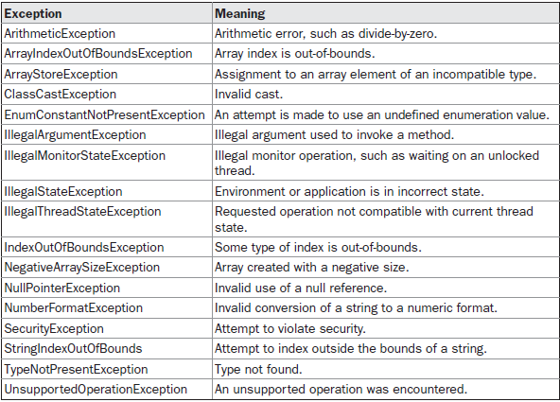
Unchecked Exception

Slide 67
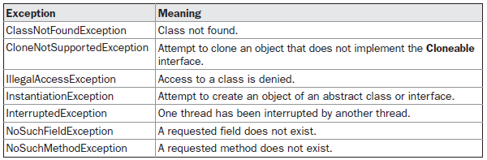
Checked Exception

Slide 68
Creating Your Own Exception Subclasses
Although Java’s built-in exceptions handle most common errors, you will probably want to create your own exception types to handle situations specific to your applications.
This is quite easy to do: just define a subclass of Exception (which is, of course, a subclass of Throwable).
Your subclasses don’t need to implement anything—it is their existence in the type system that allows you to use them as exceptions.
The Exception class does not define any methods of its own. It does, of course, inherit those methods provided by Throwable. Thus, all exceptions, including those that you create, have the methods defined by Throwable available to them. They are shown in Table

Slide 69
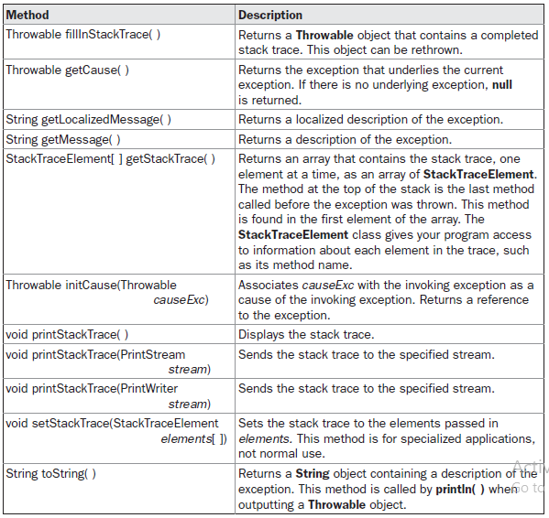

Slide 70
You may also wish to override one or more of these methods in exception classes that you create.
Exception defines four constructors. Two were added by JDK 1.4 to support chained exceptions, described in the next section. The other two are shown here:
Exception( )
Exception(String msg)
The first form creates an exception that has no description. The second form lets you specify a description of the exception.
Although specifying a description when an exception is created is often useful, sometimes it is better to override toString( ).
Here’s why: The version of toString( ) defined by Throwable (and inherited by Exception) first displays the name of the exception followed by a colon, which is then followed by your description.
By overriding toString( ), you can prevent the exception name and colon from being displayed.
This makes for a cleaner output, which is desirable in some cases. The following example declares a new subclass of Exception and then uses that subclass to signal an error condition in a method.
It overrides the toString( ) method, allowing a carefully tailored description of the exception to be displayed.

Slide 71
// This program creates a custom exception type.
class MyException extends Exception {
private int detail;
MyException(int a) {
detail = a; }
public String toString() {
return "MyException[" + detail + "]"; }}
class ExceptionDemo {
static void compute(int a) throws MyException {
System.out.println("Called compute(" + a + ")");
if(a > 10)
throw new MyException(a);
System.out.println("Normal exit"); }
public static void main(String args[]) {
try { compute(1); compute(20);}
catch (MyException e) {
System.out.println("Caught " + e);}}}
This example defines a subclass of Exception called MyException. This subclass is quite simple: it has only a constructor plus an overloaded toString( ) method that displays the value of the exception.
The ExceptionDemo class defines a method named compute( ) that throws a MyException object. The exception is thrown when compute( )’s integer parameter is greater than 10.
The main( ) method sets up an exception handler for MyException, then calls compute( ) with a legal value (less than 10) and an illegal one to show both paths through the code. Here is the result:
Called compute(1)
Normal exit
Called compute(20)
Caught MyException[20]

Slide 72
Chained Exceptions
In the first form, causeExc is the exception that causes the current exception. That is, causeExc is the underlying reason that an exception occurred.
The second form allows you to specify a description at the same time that you specify a cause exception.
These two constructors have also been added to the Error, Exception, and RuntimeException classes.
The chained exception methods added to Throwable are getCause( ) and initCause( ). These methods are shown in Table 10-3 and are repeated here for the sake of discussion.
Throwable getCause( )
Throwable initCause(Throwable causeExc)
The getCause( ) method returns the exception that underlies the current exception. If there is no underlying exception, null is returned.
The initCause( ) method associates causeExc with the invoking exception and returns a reference to the exception.
Thus, you can associate a cause with an exception after the exception has been created.
However, the cause exception can be set only once. Thus, you can call initCause( ) only once for each exception object. Furthermore, if the cause exception was set by a constructor, then you can’t set it again using initCause( ).
In general, initCause( ) is used to set a cause for legacy exception classes that don’t support the two additional constructors described earlier.
Beginning with JDK 1.4, a new feature has been incorporated into the exception subsystem: chained exceptions.
The chained exception feature allows you to associate another exception with an exception.
This second exception describes the cause of the first exception. For example, imagine a situation in which a method throws an ArithmeticException because of an attempt to divide by zero.
However, the actual cause of the problem was that an I/O error occurred, which caused the divisor to be set improperly.
Although the method must certainly throw an ArithmeticException, since that is the error that occurred, you might also want to let the calling code know that the underlying cause was an I/O error.
Chained exceptions let you handle this, and any other situation in which layers of exceptions exist.
To allow chained exceptions, two constructors and two methods were added to Throwable.
The constructors are shown here:
Throwable(Throwable causeExc)
Throwable(String msg, Throwable causeExc)

Slide 73
Here is an example that illustrates the mechanics of handling chained exceptions:
// Demonstrate exception chaining.
class ChainExcDemo {
static void demoproc() {// create an exception
NullPointerException e =
new NullPointerException("top layer");
// add a cause
e.initCause(new ArithmeticException("cause"));
throw e;
}
public static void main(String args[]) {
try {
demoproc();
} catch(NullPointerException e) {
// display top level exception
System.out.println("Caught: " + e);
// display cause exception
System.out.println("Original cause: " +
e.getCause());
}
}
}
The output from the program is shown here:
Caught: java.lang.NullPointerException: top layer
Original cause: java.lang.ArithmeticException: cause
In this example, the top-level exception is NullPointerException.
To it is added a cause exception, ArithmeticException. When the exception is thrown out of demoproc( ), it is caught by main( ).
There, the top-level exception is displayed, followed by the underlying exception, which is obtained by calling getCause( ).
Chained exceptions can be carried on to whatever depth is necessary. Thus, the cause exception can, itself, have a cause.
Be aware that overly long chains of exceptions may indicate poor design. Chained exceptions are not something that every program will need.
However, in cases in which knowledge of an underlying cause is useful, they offer an elegant solution.

